Slide 1
Suggested approach to Ambulatory Plastic Surgery in the era of COVID-19
Thomas Fiala, MD, MBA
April 16, 2020
Subject to change, as new data emerges.

Slide 2
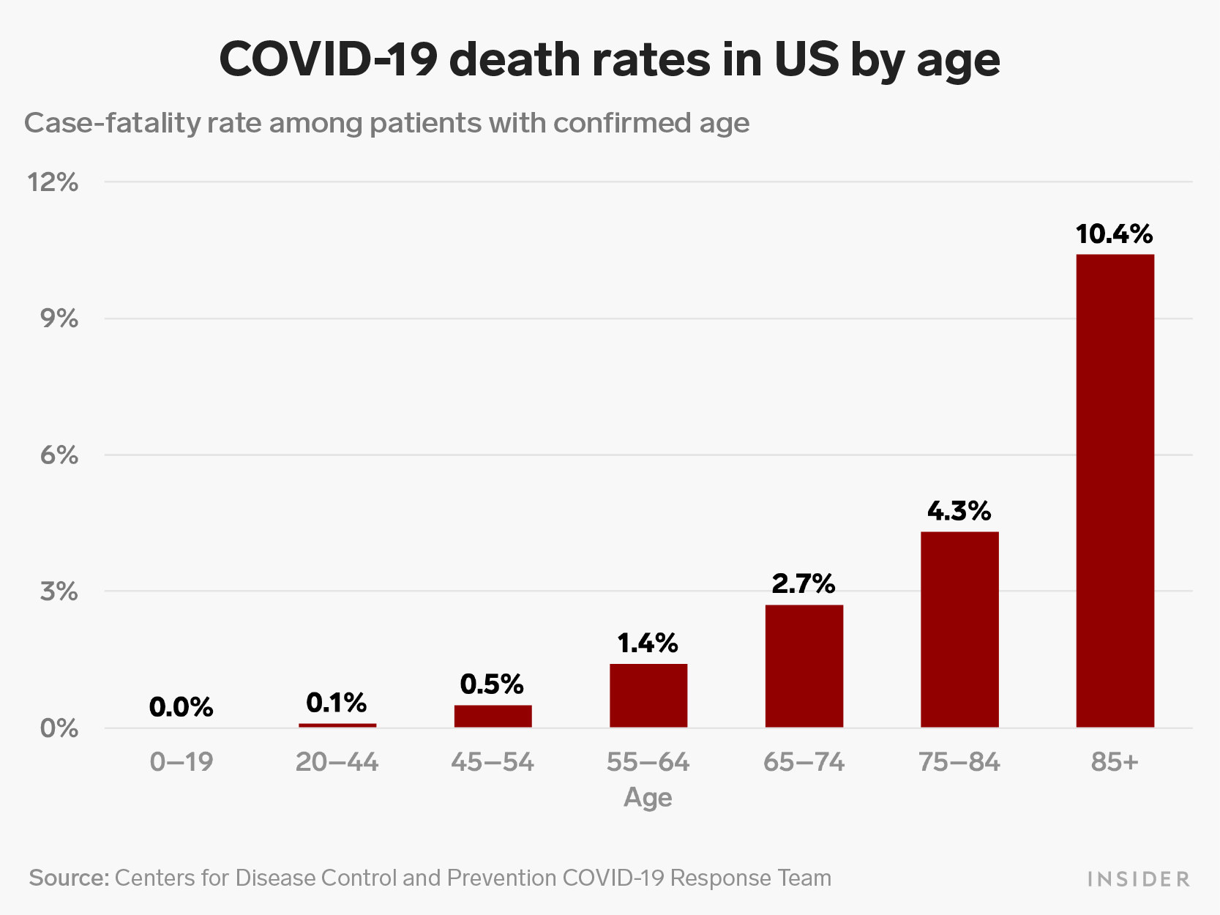

Slide 3
The enemy
Structure and genome of (SARS-CoV-2).
There are four structural proteins: spike (S) surface glycoprotein (purple); membrane (M) protein (orange); nucleocapsid (N) protein (blue); and envelope (E) protein (green).
Genomic RNA is shown encased in the N protein.
Source: https://www.ncbi.nlm.nih.gov/pmc/articles/PMC7139247/

Slide 4
Underlying concepts
Many COVID positive patients are asymptomatic.
50% in Icelandic study. 60%+ on USS Theodore Roosevelt.
Typical incubation period: 2-7 days shedding virus
Severe cases average 13 days of ventilator support.
Exposure to anesthesia in pre-symptomatic patients is BAD.
Chinese data – 10X death rate / 20.5% mortality, in study of complex surgeries, ASA 2-4. How does this apply to us?
Source: https://www.ncbi.nlm.nih.gov/pubmed/32292899

Slide 5
Rapid Progression of Severe & Critical Cases

Slide 6
Severity Categories – WHO / Chinese Clinical Criteria
mild | moderate | severe | Critical
Non-specific symptoms only | Signs & symptoms of pneumonia | RR > 30 O₂ Sat < 93% on room air | ARDS resp. failure Shock Organ failure ICU support
No sign of pneumonia on imaging | CXR – positive | Worsening of CXR in last 1-2 days > 50%
 | No need for supplemental O₂ |  | Ventilator / ECMO ICU care

Slide 7
Can we safely operate in clinically negative patients?
DUE TO HIGH ASYMPTOMATIC RATE:
CAN’T RELY ON SYMPTOM SCREENING ALONE.
“Be selective about the elective (surgery)”
Start with lower risk patients & procedures

Slide 8
“Make the aesthetic patient prove to you
that they are COVID negative,
before you offer them surgery.”

Slide 9
Recommendation: Test all elective surgery patients, with RT-PCR tests. Ideally, test within 72 hours of procedure. (Not required for true emergencies)

Slide 10
Testing types - review
RT-PCR – Gold standard for diagnosis.
Uses oro-pharyngeal and/or naso-pharyngeal swab to test for viral RNA. Saliva tests now show promise. Tends to be more accurate early in disease.
Virus shedding present.
Use for pre-op screening.
Serology – blood test for antibodies. Use in diagnosis not recommended.
IgM – first to rise- about 1-2 weeks (3-42 d). Infected.
IgG – rises later. – about 4 weeks (5-47d). Has experienced infection.
Not everyone makes adequate levels of IgG.
Some levels are too low for current tests to detect.
Lots of bad tests on market.
Evolving role – too early to tell.
WHO says “can’t assume immunity”, even with IgG detection.

Slide 11
Some sources of COVID tests, as of 4/2020. No endorsement implied.
Easiest:
FDA-approved Home test with Mail-in:
Pixel by LabCorp ($119) – anterior nasal swab
MicroGenDX ($99) – saliva test
Usually a 24-48 hr turn-around after receipt of test.
Some RT-PCR machines are FDA approved for use in your ASC / office, but they still require CLIA lab certification.
Cepheid “Xpert Xpress”
Abbott Labs “ID Now”
Mesa Biotech “Accula Sars-2”
More at: https://www.fda.gov/medical-devices/emergency-situations-medical-devices/emergency-use-authorizations#covid19ivd

Slide 12
Consider a Tiered Roll-out for Elective Outpatient Surgery, beginning with the healthiest.
Phase I: Only the asymptomatic, healthy
ASA I, no COVID co-morbidities, age <60
Consider initially avoiding:
rhinoplasty / septoplasty? – high viral load
intra-oral, sinus, airway procedures?
tummy tuck, due to change in pulmonary status?
long combination surgery?
Phase II:
Carefully Selected ASA I and II
Avoid known factors that increase risk of a bad COVID episode.

Slide 13
Factors associated with poor COVID outcomes
Increasing Age (esp. age>65)
Male sex
Obesity (BMI>35)
Lung Diseases (e.g. COPD, interstitial lung diseases, pulmonary fibrosis, pulmonary hypertension)
Obstructive Sleep Apnea
Cardiovascular Disease (Hypertension, Coronary Artery Disease, CHF)
Diabetes Mellitus
Kidney Disease (Glomerulonephritis / Renal Impairment, etc.)
Autoimmune Disease
Immunosuppressive medications (steroid use / DMARDS & biologics** / transplant medications)
Hypercoagulable conditions
Length of surgery
Potential need for blood transfusion
**DMARD = disease modifying anti-rheumatic drugs, such as azathioprine, methotrexate, leflunomide
**Biologics = Humira, Enbrel, Remicade and others.

Slide 14
Symptom Screening & Testing flowchart for patients deemed appropriate for outpatient aesthetic surgery
12-14 days prior:
Symptom screen + temp check.
Caregiver & family healthy.
positive
Surgeon notified.
Case rescheduled.
Patient referred to COVID management team.
Neg.
COVID-19 RT-PCR test
Target date for test: 3-4 d pre-op. Change date if OR date changes.
positive
Neg. (Pt. must continue social distancing until surgery)
Day of surgery:
Symptom screen + temp check. Caregiver & family healthy.
Bedside rapid test if available.
positive
Symptoms:
Any of the following new/acute symptoms
Fever (objective or subjective)
Dyspnea, cough or other respiratory symptoms
Unexplained muscle aches
GI symptoms (nausea, vomiting, diarrhea)
Loss of taste or smell
Conjunctivitis
Chills / Shaking chills
Age > 70: confused, dizzy, falls, mental status change
Close proximity to lab-proven COVID patient for > 5 minutes, without PPE
Neg.
Outpatient Surgery
At Office /ASC,
not hospital
* Current standard, as of 4/23/20

Slide 15
Legal Issues
Use new “add-on” document that discusses ASC / office policy for COVID-19
Now available from ASAPS and ASPS websites

Slide 16
Protect yourself. Protect your team. Plan ahead. Use enhanced PPE liberally.

Slide 17
N95 “respirators” vs. surgical mask
Surgical face masks:
Stops splashes, sprays & large particles.
They do not seal tightly against face.
Not a good protector against small particulates.
Do not use a “laser” mask as PPE for COVID.
N95 respirator:
Tightly fits user’s face – no gaps at side or top.
Filters 95% of “Non-oily” small particulates
NIOSH certified
Need for fit-testing.

Slide 18
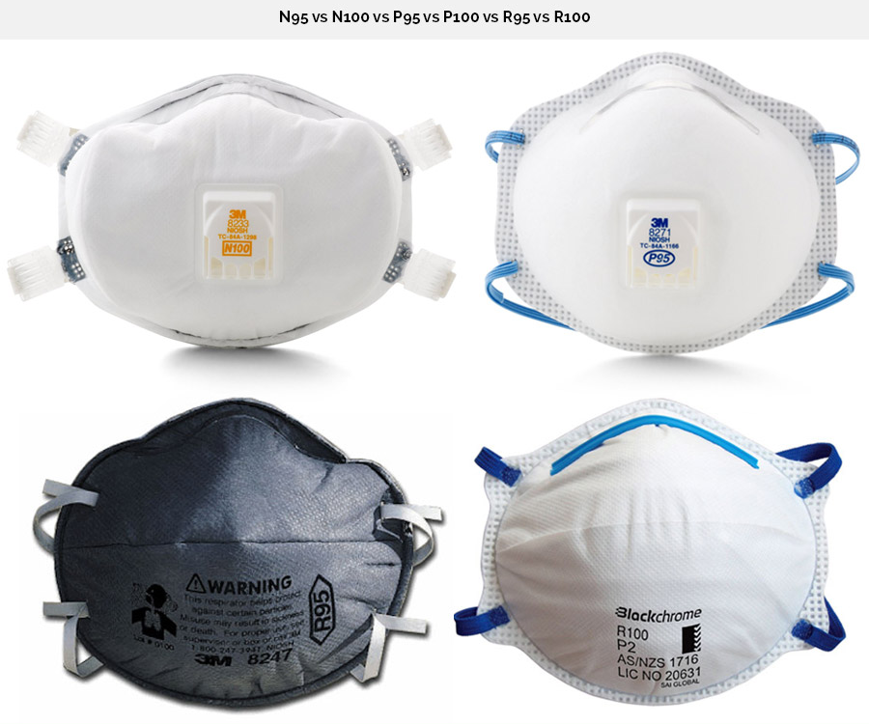
Valve type respirator.
Ok for clinic
Non-Valve type respirator.
Use for OR.

Slide 19
Valve vs. no-valve N95
N95 with Valve
Lets air & moisture escape: more comfortable
Protects when breathing in = you’re OK
Protects you. Doesn’t protect people around you.
Don’t use if you think you are ill.
Not suitable for use in sterile field.
No-valve:
Air filtration in both directions
Protects you and the people around you.
CDC recommends for use in OR with sterile field

Slide 20
NIOSH jargon
N95 respirators remove at least 95% of airborne particles with a size of 300nm (0.3micron)
N99 respirators remove at least 99% of airborne particles.
N100 respirators remove at least 99.97% of airborne particles
N95 is similar to FFP2 (Europe), P2 (Australia), DS (Japan), KN95 (China). These are acceptable substitutes.
The “N” refers to use with “non-oily particulates”

Slide 21
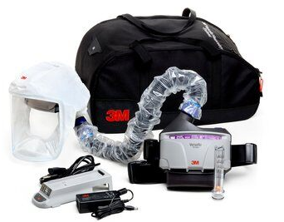
PAPR: “Powered Air Purifying Respirator”
Incompatible with surgical headlights, loupes
Can be used by anesthesia for high-risk cases.

Slide 22
Stratification of PPE used in OR, based on type of Anesthesia & Procedure
1 - GA, low-risk procedure, asymptomatic patient
2 - GA, moderate or high risk procedure, asymptomatic
3 - GA – Any procedure in COVID positive or PUI.
Emergency only.
4 - Local / regional block – low risk procedure, asymptomatic
Deep IV sedation not currently recommended, in case of loss of airway control, and need for crash intubation.

Slide 23
Scenario | Anesthesia | Surgery / Scrub & Circulator | Notes
Asymptomatic, Low risk surgery with GA (group #1) | Reusable N95 face-shield / goggles or PAPR for both intubation & extubation. Gown Double glove | Traditional mask, gown & gloves if NOT present for airway placement, otherwise wear the same as anesthesia. | Non-anesthesia providers to leave room for intubation & extubation. Wait 15 minutes for re-entry. Can’t wait? - then wear reusable N95 and face-shield, gown, gloves.
Asymptomatic, Mod-high risk surgery with GA (group #2) High risk – most ENT procedures & scopes, nose / intra-oral, ablative laser resurfacing. Mod risk – ?most facial procedures | Reusable N95 face-shield / goggles or PAPR for entire procedure Gown Double glove | Reusable non-valve N95. N99 for high risk. face-shield or goggles for entire procedure Gown (non-sterile for circulator) Glove (single OK) | Enhanced PPE to be worn by all members throughout procedure. Minimize number of people in OR.

Slide 24
Scenario | Anesthesia | Surgery / Scrub & Circulator | Notes
Symptomatic or PUI with GA. EMERGENCY ONLY (group #3) | Single-use N95 or N99. face-shield / goggles or PAPR. Gown Double glove Consider acrylic intubation screen | Single-use non-valve N95 or N99. face-shield or goggles for entire procedure Gown (non-sterile for circulator) Glove (single OK) | Enhanced PPE to be worn by all members throughout procedure. Minimize number of people in OR. DO AT HOSPITAL, not OFFICE OR ASC, UNLESS URGENT THREAT TO PATIENT SAFETY Minimize operating time Can this be done with local / regional?
Asymptomatic patient for low risk surgery with regional /local anesthesia | Traditional mask Glove (single OK) | Traditional mask, gown & gloves if site below the clavicle. Consider N95 if above the clavicle.

Slide 25
Other changes to OR Routine
Keep OR doors closed as much as possible.
Signage on doors regarding need for PPE, prior to entry. No excuses.
No visitors & observers in OR.
Remove all supplies & meds from OR, bring in only what you need. Plan ahead.
Discuss new anesthesia recommendations, including:
HEPA filter at Y-piece and expiratory limb for circuit.
Use of in-line ETT suction device. Leave distal filter attached to ETT during disconnects.
Keeping yankauer suction in empty saline bottle between uses.
5 minute pre-oxygenation to avoid desaturation & need for BVM.
Consider video laryngoscopy for ETT. Avoid awake fiberoptic intubation, deep sedation.
Avoiding mask ventilation, if possible.
Once ETT secure, use outer gloves to sheath soiled laryngoscope & blade, place in ziploc bag. Perform hand hygiene & put on new gloves. Wipe down anesthesia monitors & machine once ETT secured.
Source: UCSF: Anesthesia Adult & Pediatric Perioperative Guidelines for Care of Confirmed / Suspected Patients with COVID-19 at UCSF.

Slide 26
Other changes to OR Routine
Leave unnecessary personal items outside.
OR phone in speaker mode. Sanitize cell phones / pagers in OR. Use disposable pens & markers.
Clean stretcher handles & IV poles with wipes prior to leaving OR.
Consider a surgical mask for extubated patients during transport.
Terminal cleaning of OR, including phones, door knobs, computer keyboard & mouse. Isopropyl alcohol, 60-70%, is a good virucidal agent.
Consider: leaving room unoccupied for 6 room air exchanges by HVAC. Consider a portable HEPA filter unit.
No family in PACU. Cover nasal cannula with surgery mask, as cough shield.
PACU nurses to wear N95 if doing nebulizers, suctioning, bag-valve masking, etc.
Do not wear scrubs home. Shower / clean before changing into clean scrubs or clothes.
Source: UCSF: Anesthesia Adult & Pediatric Perioperative Guidelines for Care of Confirmed / Suspected Patients with COVID-19 at UCSF.

Slide 27
Other considerations for surgeons
What can we do to minimize number of post-op visits?
Are drains really needed?
Closures:
Can absorbable sutures be used?
Skin glues and tapes be used?
Re-evaluate the frequency of your routine post-op appointment scheduling for each procedure. Can it be modified?
Can we educate patients even better about post-op care?

Slide 28
Ambulatory & Post-op care
Patient continues social distancing for 1-2 weeks post-op
Use of telemedicine for “wound checks” when suitable
Read CDC bulletin: Outpatient & Ambulatory Care Settings: Responding to Community Transmission of COVID-19 in the United States
10 point plan.
https://www.cdc.gov/coronavirus/2019-ncov/hcp/ambulatory-care-settings.html

Slide 29
Medi-spa services
Protect your staff!
Telephone screening prior to appointment.
All patients screened for symptoms and temperature.
Negative patients may make appointment for Botox, fillers, facials. Recheck 2-3 days prior, if possible to allow for re-scheduling.
In-office screening prior to treatment session.
All patients screened for symptoms and temperature.
Negative patients may have treatment for Botox, fillers, facials.
Listerine / Chlorhexidine / ½ strength Peroxide mouth rinse.
pHisoHex face wash?
PPE for Provider for facial treatments (i.e. Botox & fillers, microneedling, facials )
Reusable N95 facemask, eye shields, single gloves OK for provider
Can patient wear a surgical mask? (i.e. Botox to forehead & glabella)
PPE for Provider for non-facial treatments:
Traditional PPE
Patient to wear surgical mask.

Slide 30
Selected readings
Lei, S. et al. Clinical Characteristics and Outcomes of Patients Undergoing Surgeries During the Incubation Period of COVID-19 Infection. https://www.ncbi.nlm.nih.gov/pmc/articles/PMC7128617/
Stahel, PF. How to risk stratify elective surgery during the COVID-19 pandemic.
https://www.ncbi.nlm.nih.gov/pubmed/32288785
AORN guidelines: https://www.aorn.org/guidelines/aorn-support/roadmap-for-resuming-elective-surgery-after-covid-19
Topf, MC, et al. A Framework for Prioritizing Head and Neck Surgery during the COVID‐19 Pandemic. https://onlinelibrary.wiley.com/doi/abs/10.1002/hed.26184
Global guidance for surgical care during the COVID‐19 pandemic. COVIDSurg Collaborative. https://bjssjournals.onlinelibrary.wiley.com/doi/full/10.1002/bjs.11646
Ti, LK, et al. What We Do When a COVID-19 Patient Needs an Operation: Operating Room Preparation and Guidance. https://www.ncbi.nlm.nih.gov/pmc/articles/PMC7090746/
Bann, DV. Impact of Coronavirus (COVID-19) on Otolaryngologic Surgery: Brief Commentary. https://www.ncbi.nlm.nih.gov/pubmed/32270565
Peng, P, et al, Outbreak of a new coronavirus: what anaesthetists should know. https://bjanaesthesia.org/article/S0007-0912(20)30098-2/fulltext
Peng, F, et al. Management and Treatment of COVID-19: The Chinese Experience. https://www.ncbi.nlm.nih.gov/pmc/articles/PMC7162773/

